Slide 1
The video of this presentation is here
Connect () 2017
Notes:
https://channel9.msdn.com/Events/Connect/2017/G102

Slide 2

Microsoft AI Platform
Joseph Sirosh
Corporate Vice President
Artificial Intelligence & Research Group
@josephsirosh
Notes:
Good afternoon. I am excited to have you join us at Connect().
We’ll be showing you how the Microsoft AI platform is enabling every developer to infuse intelligence into their existing applications and also create new experiences for their uses.
Developers can do this in any language and on any OS.
It brings the best of the cloud to AI developers, and the best of AI to cloud developers.
It’s the most productive, open and secure cloud platform for developers to build their app.

Slide 3
The Microsoft AI platform Cloud-powered AI for every developer
Services
Tools
Infrastructure
Notes:
The AI platform is comprised of 3 layers: Services, Infrastructure and Tools.
It is entirely on Azure public compute and takes full advantage of its ongoing rich platform innovations.
It’s complemented by cross-platform tools in VS Code and Visual Studio.

Slide 4
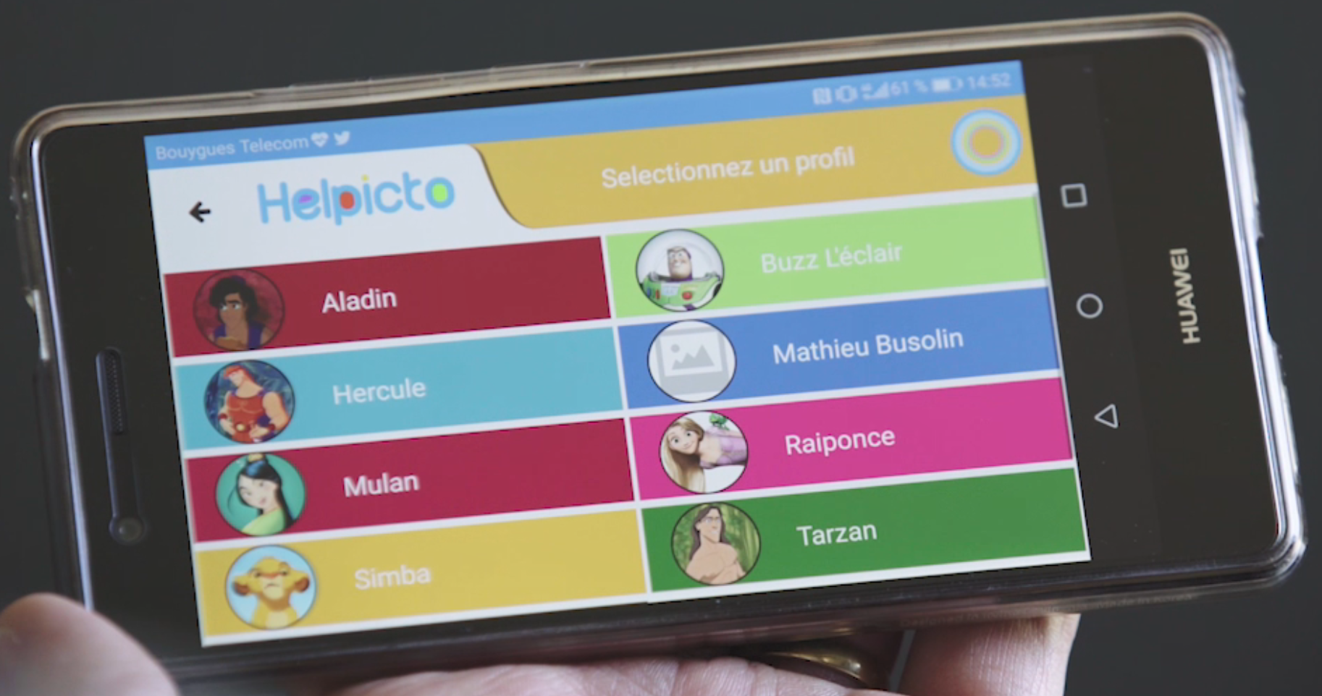
Notes:
The best way to show the power available to developers here is through a story.
Helpicto is an AI application developed by a French startup called Equadex.
It helps children with autism to communicate, based on pictograms and associated keywords.
An autistic child usually uses specific pictograms in a sequence to recognize a situation, a question, or another interaction.
Helpicto makes this easy with AI in the cloud.
<Let’s play the video>

Slide 5
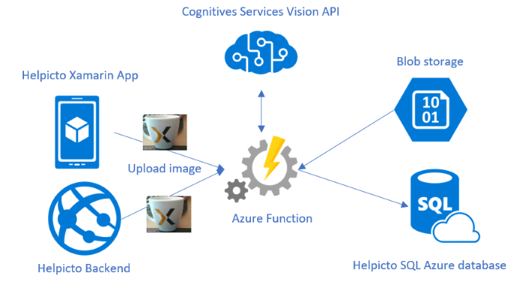
Helpicto’s Cloud Architecture
Notes:
AI enables people to tap into even greater potential
<pause>
Helpicto is a Xamarin app. Images are ingested through Azure Appservices.
Azure Functions trigger calls to intelligent APIs.
Processed results are stored in Azure SQL DB.
Applications like these are easy to assemble with the Microsoft AI Platform.

Slide 6


Understanding
Interpret meaning of data including text, voice, images
How AI can help
Reasoning
Learn & form conclusions from data
Natural UI
Engage with people in natural ways
Notes:
AI empowers us in three ways –
(1) it allows us to understand and interpret all types of data including natural language, voice and images;
(2) it allows us to reason with data – learn from it and drive intelligent action; and
(3) it allows us to interact with people in natural ways.

Slide 7
1. Cognitive Understanding of Documents
“Understanding”
Four Examples
2. Building custom AI models from data
3. Real-time AI at the edge
“Reasoning”
4. Conversational AI applications
“Natural UI”
Notes:
Today I will illustrate this power with 4 scenarios.
These are all applications built on the AI Platform <click>
1. Cognitive Understanding of documents <click>
2. Building custom AI models @ scale &
3. Real-time AI at the edge for Reasoning & Automating <click>
4. Conversational AI applications for Natural UI

Slide 8

1. Cognitive understanding of documents
Notes:
Let us start with the Cognitive Understanding of documents.
A big part of the struggle of digital transformation, is the struggle to organize information stored in large piles of digital attics. <click>

Slide 9
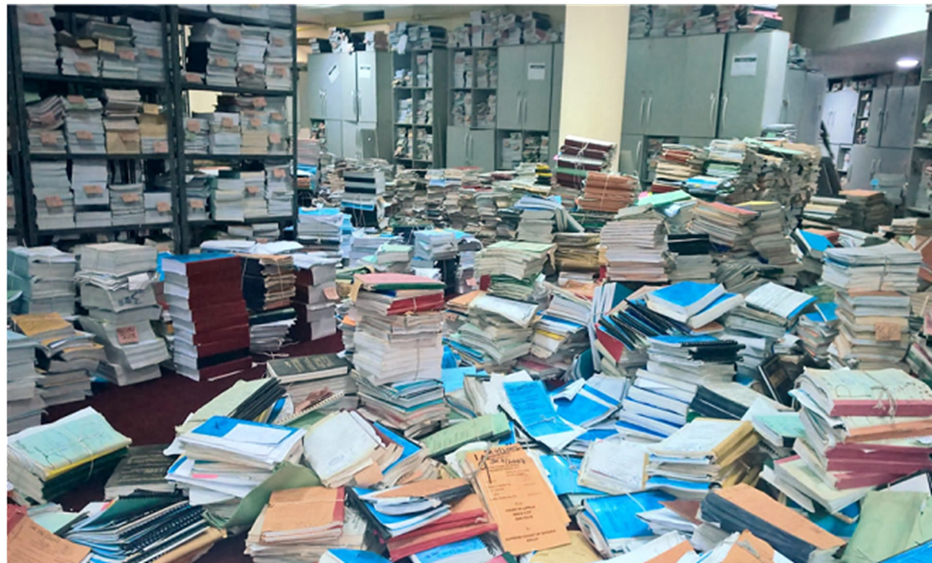
messy room picture here
Notes:
Here is a picture from one of our customers in Nigeria.
While every enterprise may not have a pile of documents such as this room, most of them sit on a pile in a digital attic stored away somewhere in their archives.
These digital attics are as intimidating as the physical documents in this room.
Just think about what it would take to understand the content of this room and find something!
<pause>
The best way to show the power of AI to help here is with a demo.

Slide 10


Corom Thompson
Principal Engineer
@CoromThompson
Notes:
Corom Thompson is a Principal Engineer in my team.
Within a few days, he built a powerful AI application on Azure for understanding and organizing vast amounts of unstructured data.
It uses cognitive services and Azure search, and makes all this unstructured data searchable and analyzable.
Let me welcome Corom to tell us what he did.

Slide 11
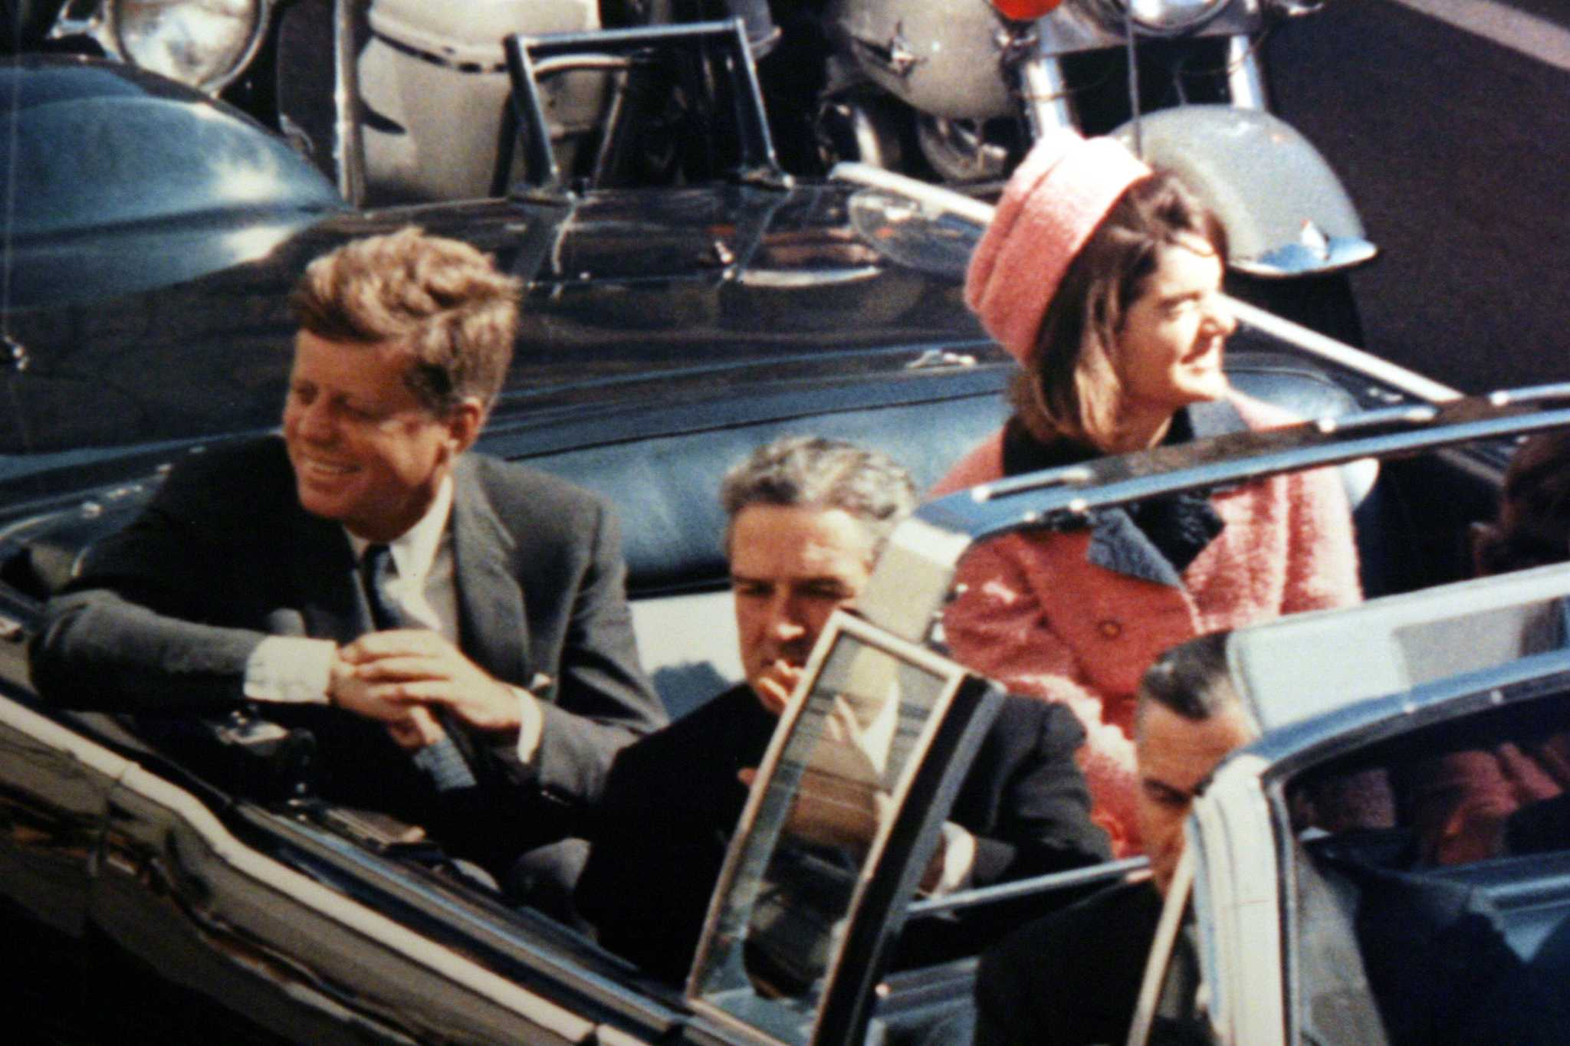

John F. Kennedy (JFK)
November 22, 1963

Slide 12




Slide 13
How do we do this?
Ingest
Enrich
Explore

Slide 14
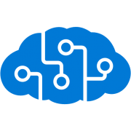

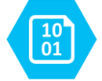
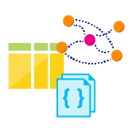
Ingest
Enrich
Explore
Cognitive skills
Data Feed
Search
Annotations
Cognitive Search Pattern
Notes:
Skills produce knowledge in the form of annotation that are stored

Slide 15
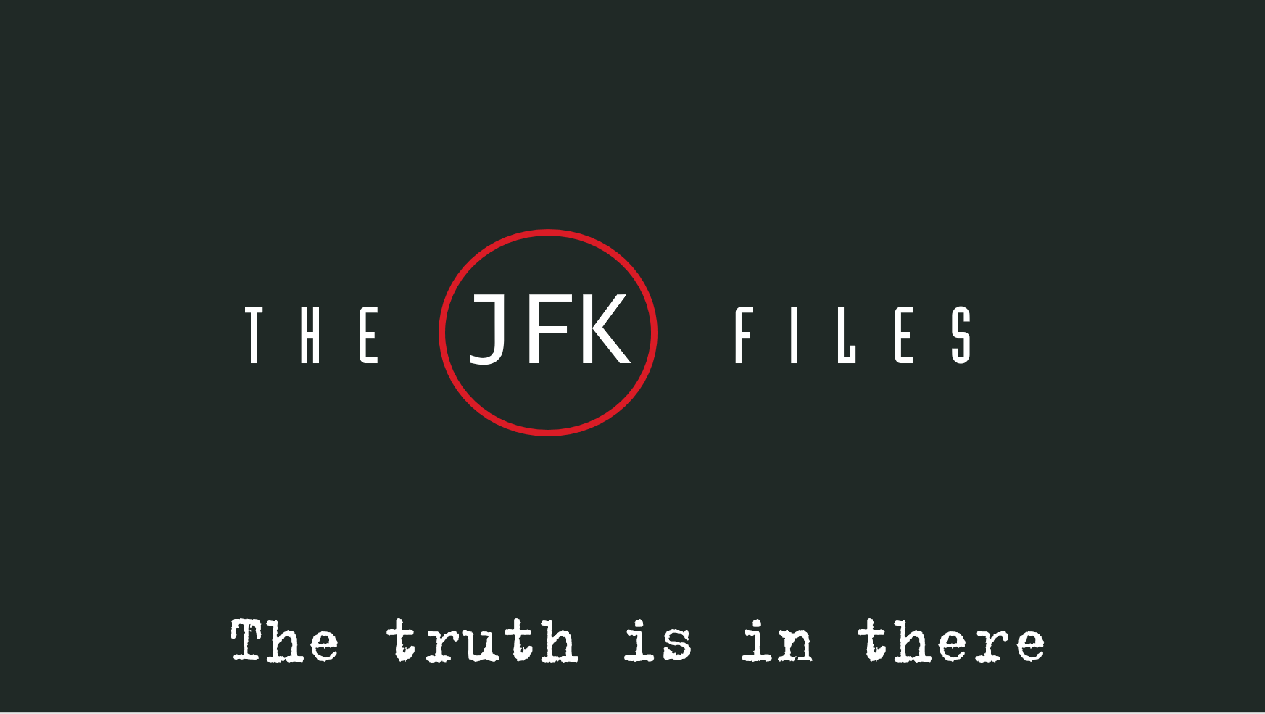
T H E JFK F I L E S
The truth is in there

Slide 16






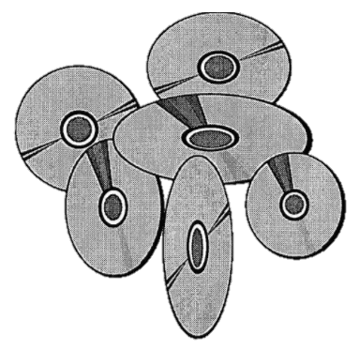


JFK FILES
COGNITIVE SEARCH
ARCHITECTURE
Custom skill: CIA Cryptonyms
Cognitive Services:
Computer Vision
OCR + Handwriting
Entity Linking
DECLASSIFIED
Azure Search
Cognitive
skill set
Blob
Storage
Azure Function
Skill: Topics
Web App
(azsearch.js)
Cosmos DB
Azure Machine
Learning

Slide 17

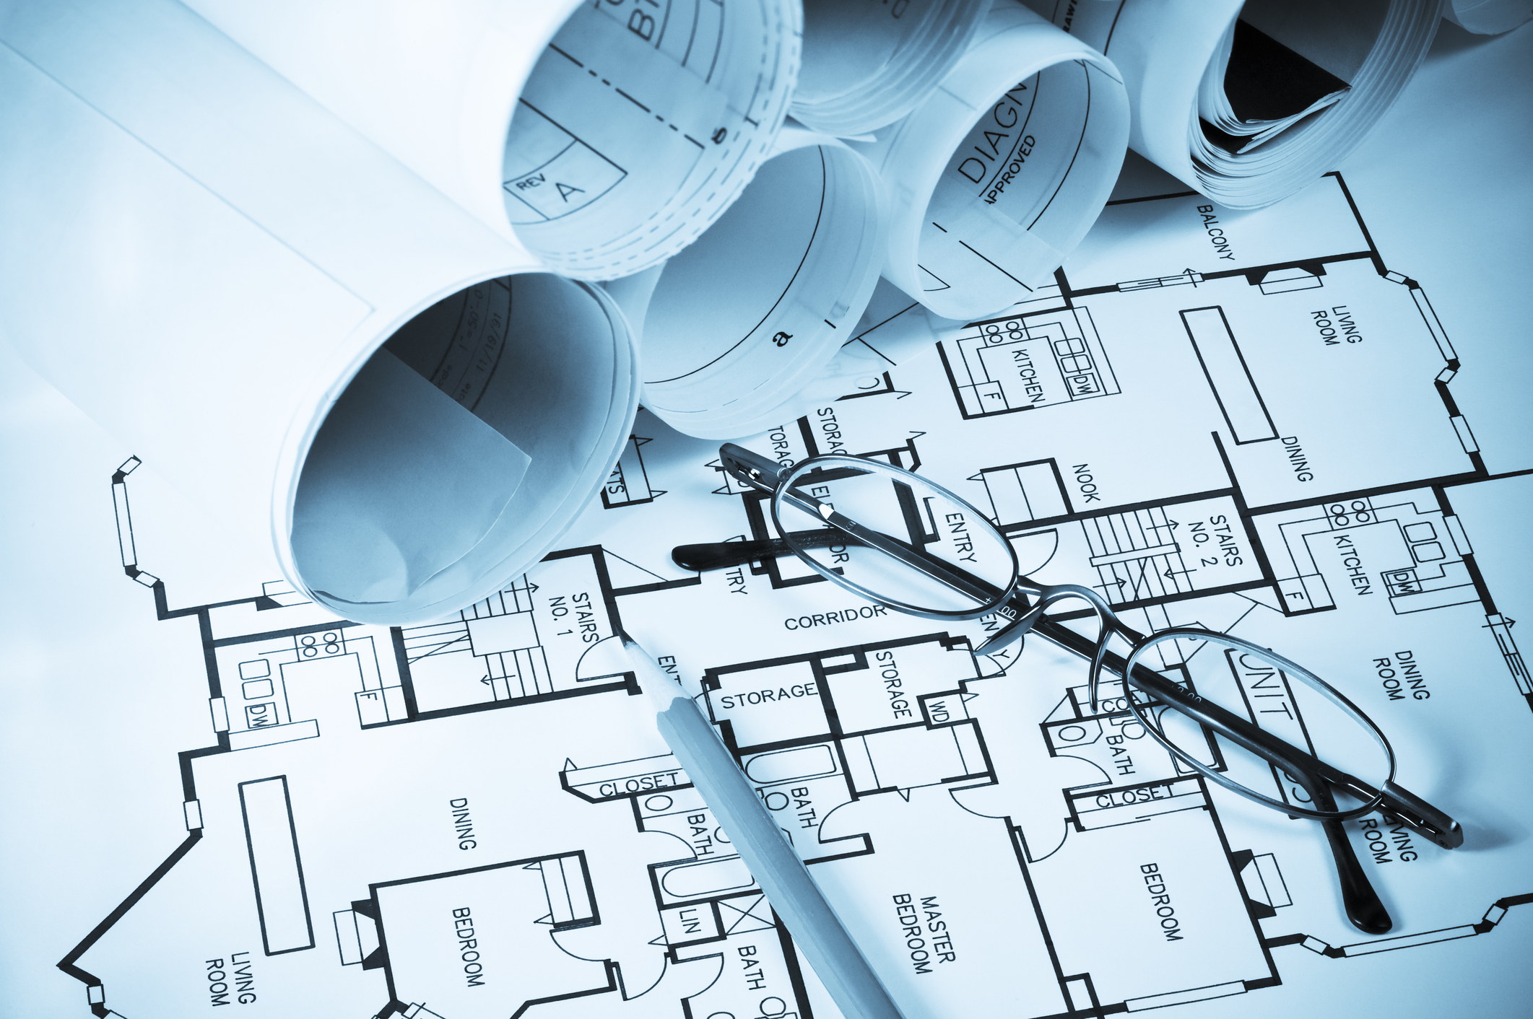

Analyzing legal contracts
Understanding engineering plans
Extracting form information
http://aka.ms/jfkfiles
Notes:
And while we showed you a problem the CIA might have, imagine how the Cognitive Search pattern could be applied on your data, or your customers’ data. Whether it’s analyzing legal contracts, understanding engineering diagrams, or automatically extracting information from manually filled forms. Come join us on our journey as we build together the solutions to power new experiences on top of your piles of unstructured data.

Slide 18
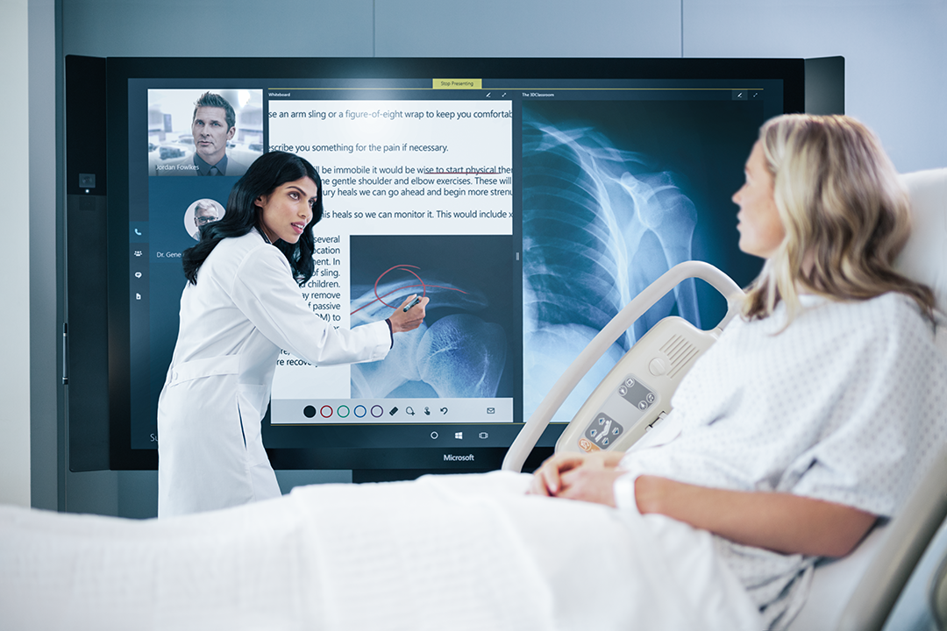

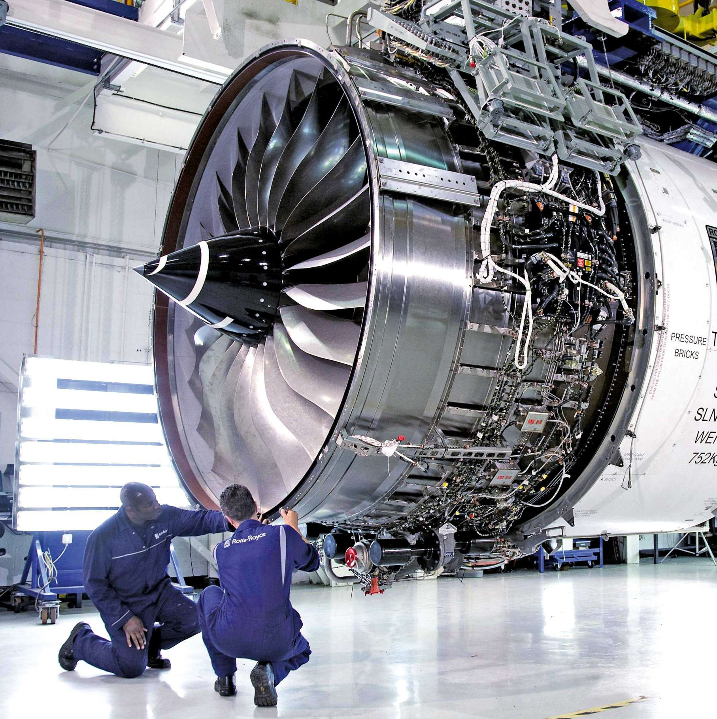



AI is now for everyone
Healthcare
Education
Manufacturing
Digital Transformation
Financial Services
Government
Retail
Notes:
Thank you Corom <click>
AI is now for everyone – from healthcare to financial services and the public sector.
Everywhere that you’re using software, AI will be there. And it will transform every aspect of business.
If you aren’t already planning for, experimenting, and deploying AI – you’re falling behind.

Slide 19
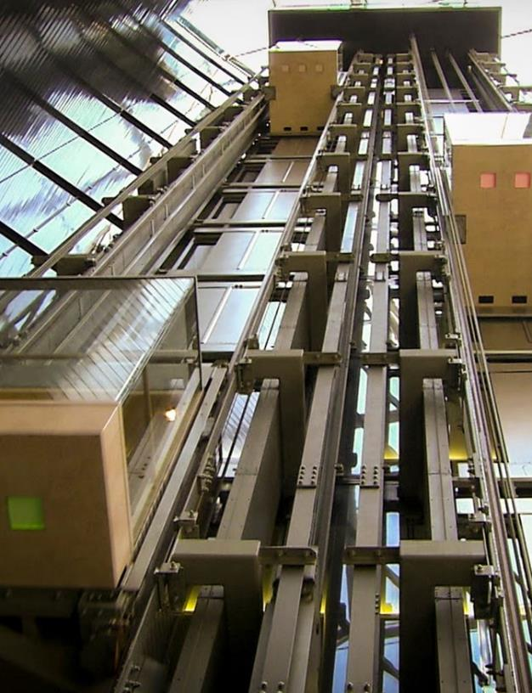
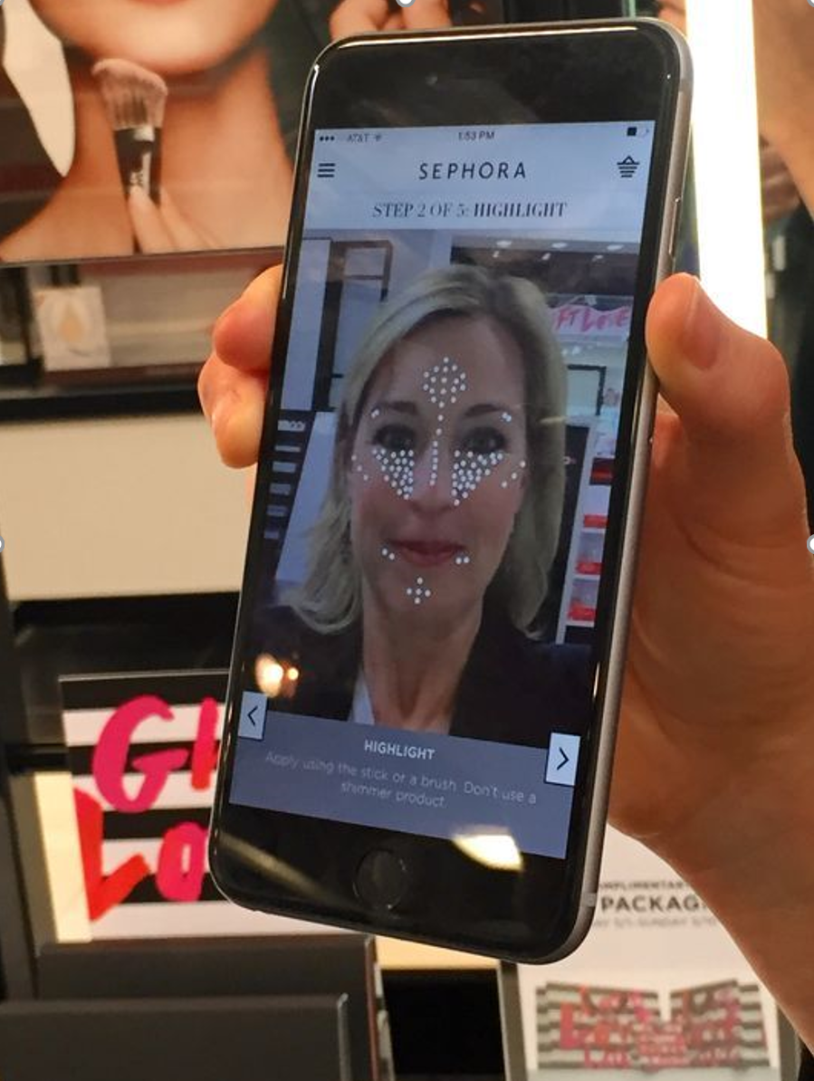

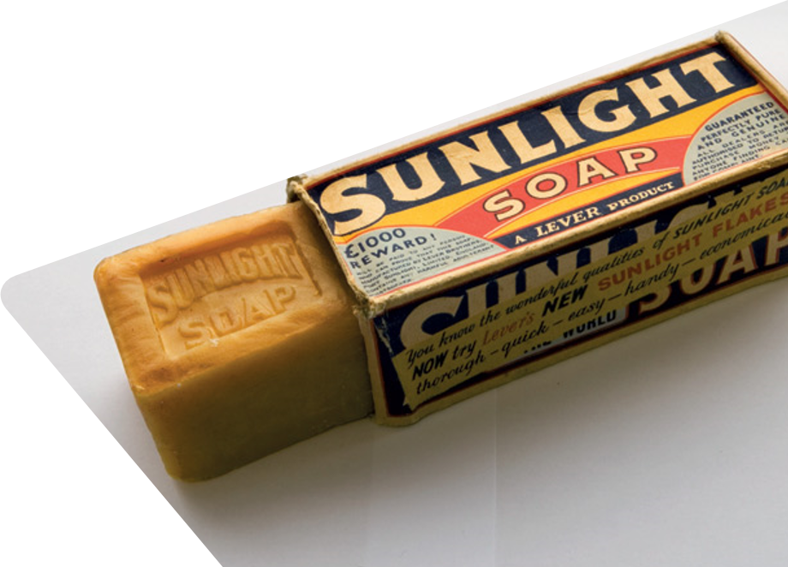



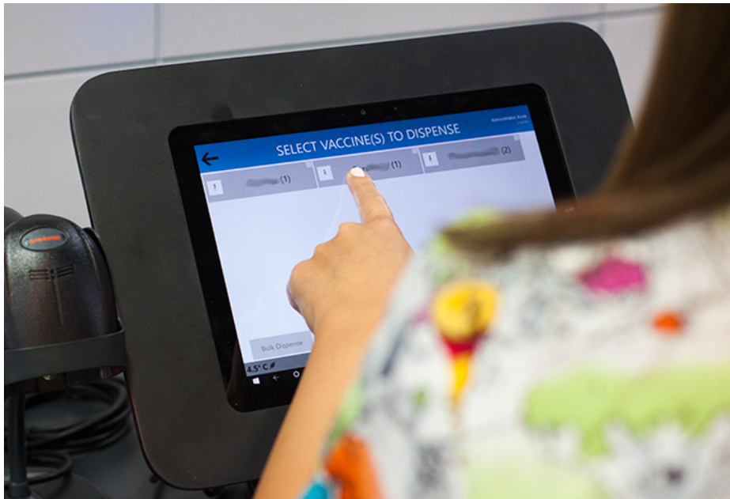




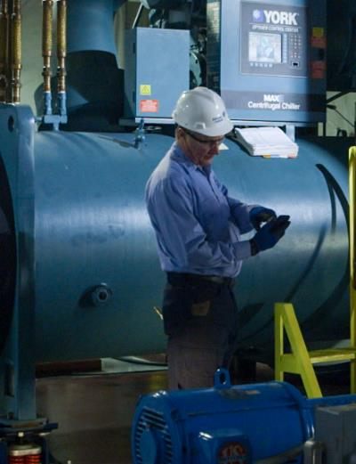



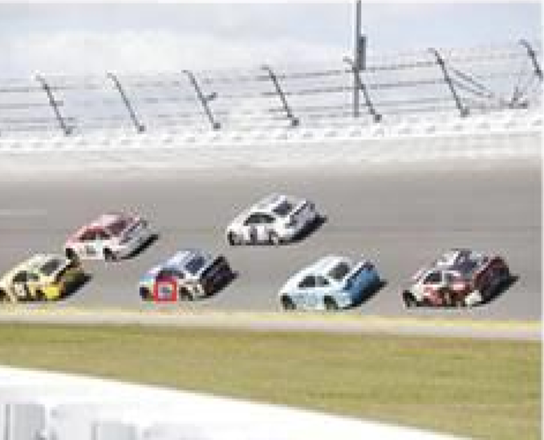




Employee Engagement
Free up HR agents to focus on more complex employee inquiries
Unilever
Filtering the signal from the noise
Used analytics to discover actionable insights around fuel usage, predictive maintenance and stop unscheduled delays.
Click
Medical Document Analysis
UCL and the Cochrane Transform Project are using AI and machine learning to text mine thousands of reports for systematic reviews.
Intelligent Recommendations
Publicis has developed an AdvisorBot App that provides intelligent products recommendations based on your Skin color, Skin tones, other facial features, geolocation, weather and contextual information
Publicis
Transforming the Energy Industry
Esmart Systems is a small startup in Norway that is revolutionizing the energy industry with AI in Azure.
.
eSmart Systems
Click
Sales Campaign Lead Generation
Reaching and engaging fans is a priority for the Trail Blazers, and our work with Azure Machine Learning has delivered real results
Fuel Level Prediction and Analysis
Fuel level prediction of racing cars and Image analysis to understand the wear and tear on the cars
Hendricks
AI Saving Snow Leopards
Using Azure powered deep learning to save snow leopards.
Notes:
All types of companies from large enterprises to startups are deploying AI. Here are a few examples.
Unilever is embarking on a major transformation in HR and employee services and as part of this digital transformation and they wanted to be able to provide a more self-service and human like approach to employees to engaging with HR. HR and Employee services also wanted to move away from agent heavy support over to automated service offerings and being able to answer employee questions through automation and BOTS using a large knowledge base of QnA and employee related queries.
Rolls Royce is filtering the signal from the noise
Used analytics to discover actionable insights around fuel usage, predictive maintenance and stop unscheduled delays
Researchers at UCL and the Cochrane Transform Project are using AI and machine learning to text mine thousands of reports to automatically select ones to include in systematic reviews. This saves weeks of monotonous work, freeing up the expert reviewers to spend their time and energy on high-level analysis.
Publicis has developed an AdvisorBot App that provides intelligent products recommendations based on your Skin color, Skin tones, other facial features, geolocation, weather and contextual information
Emarts connected Drone Service enables power line inspection with Azure and Deep Learning
Portland Train Blazers - Reaching and engaging fans is a priority for the Trail Blazers, and our work with Azure Machine Learning has delivered real results
Hendricks Motor Sports Fuel level prediction of racing cars and Image analysis to understand the wear and tear on the cars.
AI is even being used to identify snow leopards in the Himalays from automated digital camera images.

Slide 20
Systems of Engagement
Web
Mobile
Chat
Systems of Intelligence
Systems of Record
CRM
HCM
ERP
ITSM
Notes:
Let me tell you about AI’s place in the modern digital transformation.
For decades, the model has been to build Systems of Record, stores of data that are domain specific, and operate on them.
And as the web and mobile came along we built systems of engagement with customers.
But now with the richness of the cloud you can connect all this together.
With the richness of the Cloud, you can evolve to build entire systems of intelligence, that can reason over vast amounts of information – structured and unstructured.
It lives between the two and integrates all. You integrate the data in all the systems of record to drive AI infused business processes.
Conversational engagement such as chatbots becomes real and viable and drives efficiencies.
But to enable this evolution to Systems of Intelligence, AI needs a comprehensive platform.
Our platform strategy is to enable you to build end to end systems of intelligence:

Slide 21
The Microsoft AI platform Cloud-powered AI for every developer
Services
CUSTOM AI
PRE-BUILT AI
CONVERSATIONAL AI
CODING & MANAGEMENT TOOLS
Azure Machine Learning
Cognitive Services
Bot Framework
Tools
VS Tools for AI
Azure ML Studio
Azure ML Workbench
Others (PyCharm, Jupyter Notebooks…)
Infrastructure
DEEP LEARNING FRAMEWORKS
AI ON DATA
AI COMPUTE
3rd Party
Cosmos DB
SQL
DB
SQL
DW
Data Lake
Spark
DSVM
Batch AI
ACS
Edge
Cognitive Toolkit
TensorFlow
Caffe
CPU, FPGA, GPU
Others (Scikit-learn, MXNet, Keras, Chainer, Gluon…)
Notes:
The Microsoft AI Platform is cloud powered AI for every developer.
Working from the developer backwards, a the very top, we have the high level services for AI.
And Azure Machine Learning allows you to do data science and build sophisticated AI applications from the ground up.
Cognitive Services allows developers to infuse pre-built AI into every app.
The Bot Framework allows you to easily build chatbots.
This is all built on the infrastructure of the hyperscale cloud.
Here you have the power of the most advanced database services such as Cosmos DB, SQL DB, and Data Lakes to organize your data.
You have the power of distributed computing with Spark and Azure Batch and even IOT Edge.
All of this is built on the latest hardware – CPUs, GPUs and FPGAs.
And we provide great tools to assist the developer, as you will see in a moment.
Our platforms are open. They support all the popular open source frameworks for Machine Learning. And it’s easily extensible.
It’s a very rich, open, cloud based platform for highly productive application development.

Slide 22

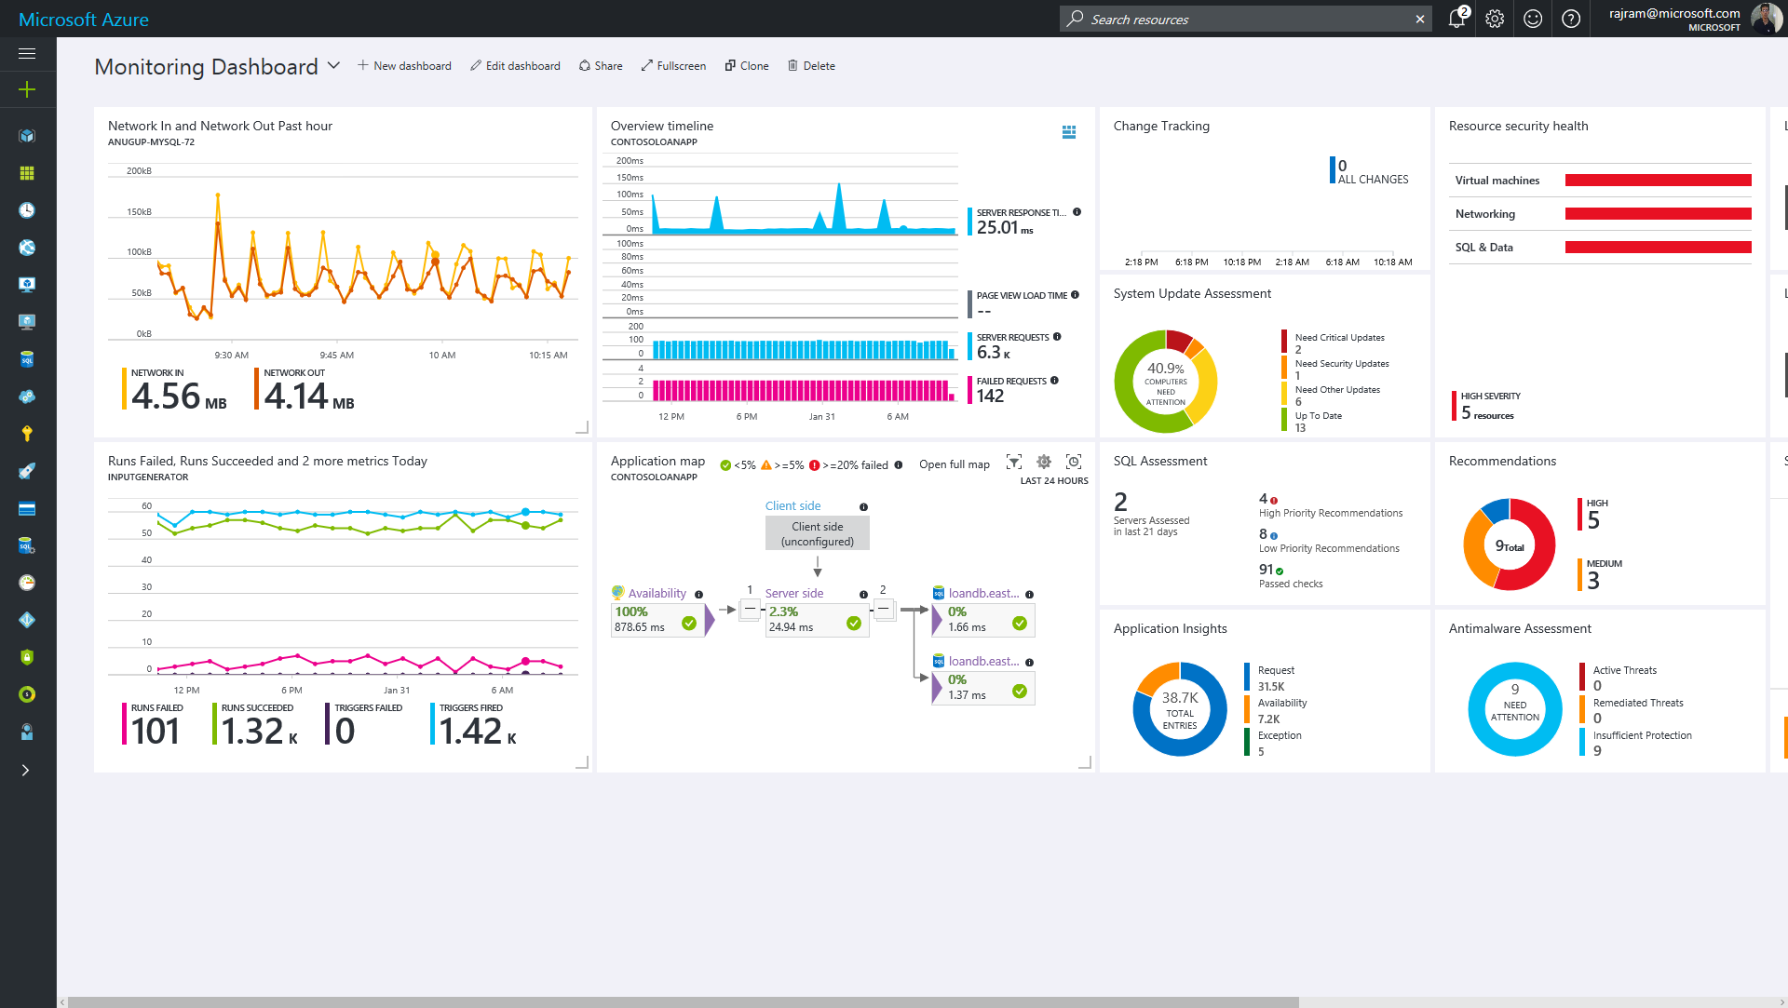
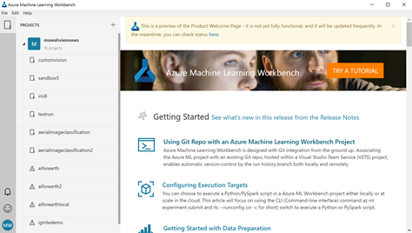
Azure Machine Learning
Productive, Scale-out, Full-lifecycle AI Development
Workbench
Wrangle Data, Build models, Deploy & Manage
Experimentation
Boost productivity with Spark, GPUs and agile development.
Model Management
Deploy, Version, Manage & Monitor Models
Notes:
Let’s talk first about building sophisticated custom AI solutions.
This is what many of our large enterprise customers want for their most mission critical applications.
The service for this is Azure Machine Learning, which enables scale-out, full lifecycle AI development.
We have 3 exciting components in Azure ML.
A Workbench client, a powerful experimentation service in the cloud, and a model deployment and management service.

Slide 23
Azure Machine Learning
Productive, Scale-out, Full-lifecycle AI Development
AI-powered Data Wrangling
E2E ML Dev
Productivity
Deploy Anywhere
E2E Tooling for AI Development
+
+
=
SPARK, GPU, Open Source
Docker, Spark, IOT Edge, On prem, AWS/GCP…
Program Synthesis
Lifecycle Management
Notes:
Think of Azure ML as a combination of three major capabilities.
AI-powered data wrangling enables data scientists to transform data without code. It uses a powerful technology to synthesize data transformation programs from examples that you show.
The experimentation service allows you to leverage all the power and parallelism of the cloud. It supports GPUs and all major open source frameworks for ML. And it tracks all your experiments for full lifecycle management.
And the model management capabilities allow you to deploy ML models in docker containers and scale them out on Kubernetes clusters.
You can deploy and manage them on IOT Edge and even on-premises or other clouds.
It is end to end tooling for ML Development.

Slide 24

2. Building custom AI models from data
Reasoning
Notes:
The best way to show the power of this service is with a demo.
This is my second scenario. Reasoning with vast amounts of data – in this case photos - and building models from that data.
We’re going to show this to you in the context of a conservation effort, run by the Snow Leopard Trust.

Slide 25
Azure Machine Learning Demo
Data Prep
Model Training
Deploy model
Spark Streaming
Dockerize
Web service
Snow Leopard Imagery
Code-free data wrangling
Azure ML Workbench
Train on HDI Spark
Notes:
This is about building a classifier for snow leopard photos.
Data Prep:
We’re going to take the photo files, and use Program Synthesis to wrangle filenames and dates.
Model Training:
Then we’re going to train some large Deep Neural Network models with the Azure ML workbench and HDI Spark on Azure.
Model Deployment:
And then we’re going to put this in production with Spark streaming. We can also dockerize the trained DNN and deploy it as a web service that can be called from any app.

Slide 26


DEMO
Mark Hamilton
Software Engineer
github.com/mhamilton723
Notes:
Now I’d like to invite Mark Hamilton, who is a software engineer in my team, to show us this example.

Slide 27
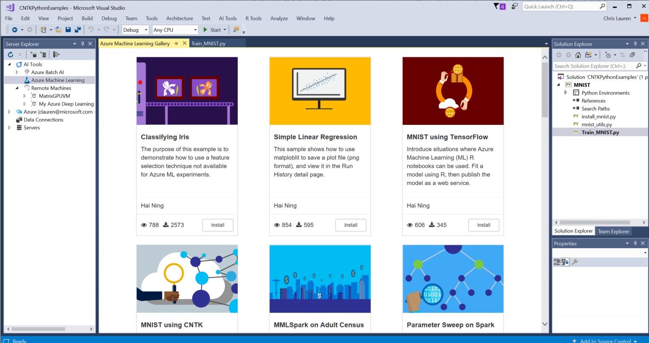
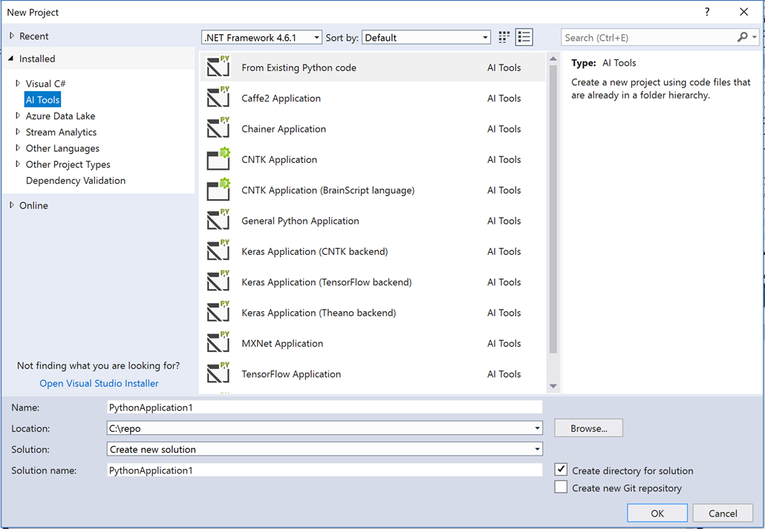
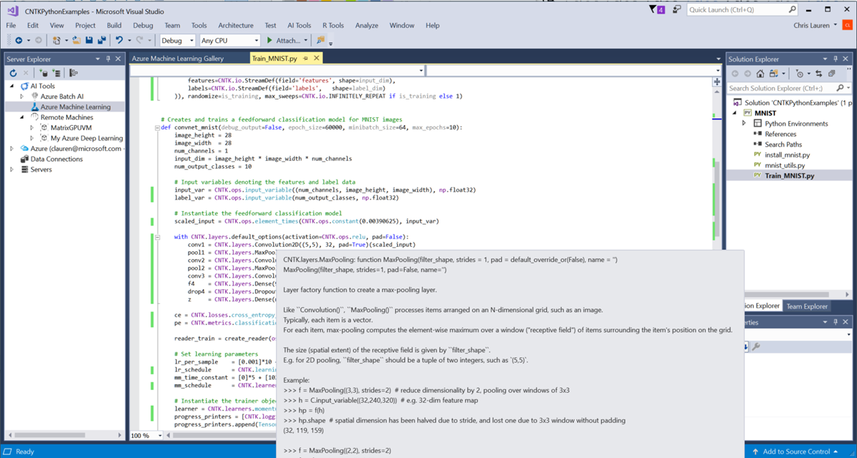
Visual Studio Tools for AI
Announcing
Integrated with Azure Machine Learning
Create new deep learning projects easily
Scale Out with Azure Batch AI
Monitor model training progress & GPU utilization
Notes:
Thank you Mark!
We believe developers and data scientists should be able to use the tools and platforms of their choice.
That’s why I am excited about this announcement.
Visual Studio Tools for AI simplifies common tasks when working in their favorite Visual Studio environment.
VS Tools for AI allows developers to build, test and deploy AI Models at scale:
Integrated with Azure Machine Learning
Create new deep learning projects easily
Developers and data scientists can run scripts locally to test, and submit jobs to a remote compute target defined in Azure ML.
Scale Out with Azure Batch
Monitor model training progress & GPU utilization
Storage Browser to upload data, copy model & view logs
Infuse AI into your apps today

Slide 28


AI @ the Edge
Notes:
In the future a lot of AI models will be used in real-time. Imagine phones or the internet of things.
Realtime Edge AI runs on the target devices. It has two advantages:
1. Low latency for local decision making
2. Reduced reliance on internet connectivity
We are enabling the capability to add a custom AI model, and through Azure ML we are training and operationalizing it to run in a Docker containers on an x64, and on edge devices using Azure IoT Edge.
Imagine the possibilities when you put the power of AI at the hands of every mobile phone user.

Slide 29
3. Real-time AI on mobile phones and the edge.
Reasoning
Notes:
The best way to show the power Building real-time models is with a demo.

Slide 30
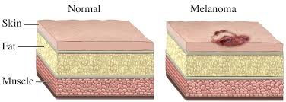
Skin Cancer
Notes:
Skin cancer is the most common form of cancer, globally accounting for at least 40% of cases. If detected at an early stage, it can be controlled.
What if we can create a real time AI app for everyone to be able to quickly detect whether they need to seek help.
The app can call attention to high risk cases from skin photos.

Slide 31
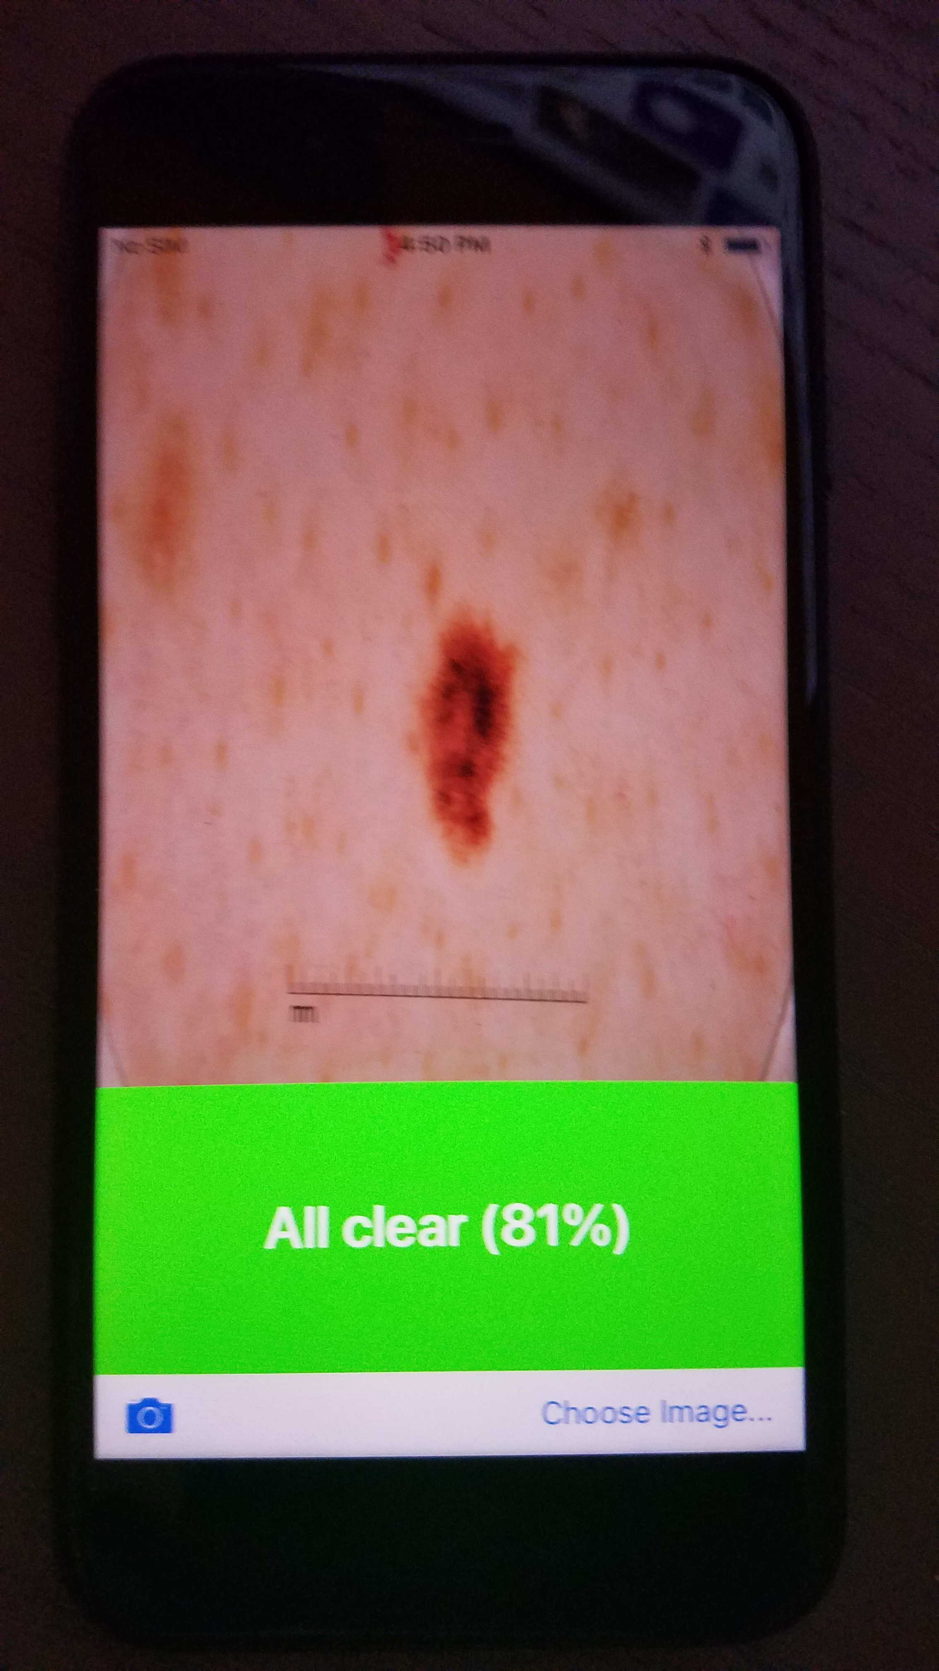
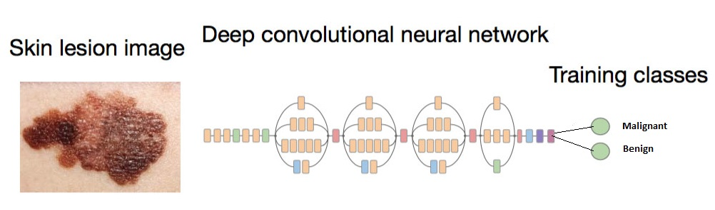
Realtime Edge AI: Skin Cancer Detection
CoreML
Xamarin
AML Workbench
Edge AI
Notes:
For this work, we use the ISIC Skin Cancer dataset. We follow 3 steps here –
1.Build the AI Model using Azure Machine Learning
-Azure Machine Learning Workbench is a cross-platform desktop application, which makes the modelling and model deployment process much faster versus what was possible before. We create a DNN using workbench to flag critical skin images.
2.Convert the model to CoreML
- With Core ML, you can integrate trained machine learning models into your app.
3.Use the CoreML model in a Xamarin application to run it on an iOS.
-A key benefit of using Xamarin is that the UI uses native controls on each platform, creating apps that are indistinguishable from an application in iOS or in Android.
I'd like to invite my colleague Anusua, to showcase how to do this.

Slide 32


DEMO
Anusua Trivedi
Data Scientist
@anurive
Notes:
DEMO 3: Custom model on CoreML → Anusua Trivedi

Slide 33
AI @ Azure IoT Edge Preview
Announcing
Infuse IoT devices with cloud intelligence
AzureML, Azure Stream Analytics, Azure Functions, AI
Cross-platform & compact
Supports Linux and Windows devices
Runs in as little as 128MBs of memory
Powerful platform for AI at the edge
AI Toolkit for Azure IoT powers next generation IoT sensors
IoT Edge Device
https://github.com/Azure/ai-toolkit-iot-edge

Slide 34

Pre-built AI
Cognitive Services and Bots to develop applications that understand us
Notes:
Now let us move from custom built AI, built by ML developers to pre-built AI.
I am a big believer in pre-fabricated components that every developer can use.
I think a lot of AI should be as simple as sorting functions or the APIs we use every day in programming.
Pre-built AI – including Cognitive Services and Bot Framework is starting to make that a reality.
It’s going to enable all developers to build applications that understand us and interact with us.

Slide 35
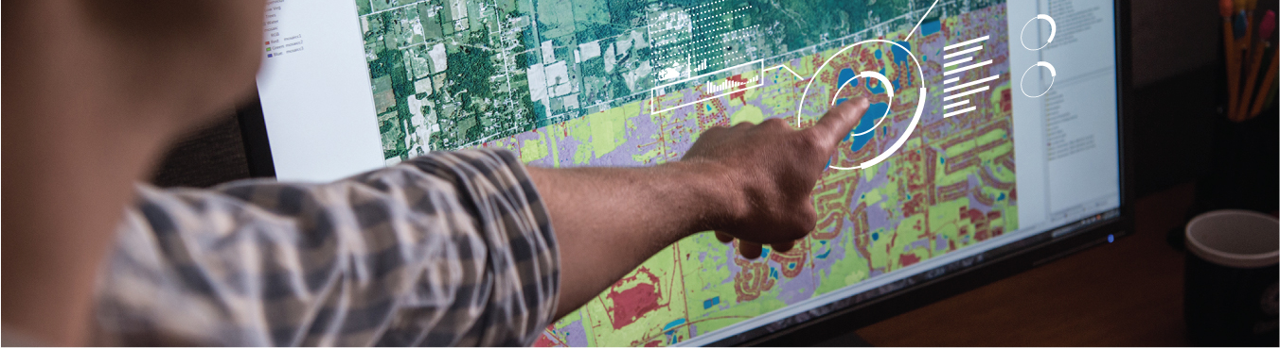


Microsoft Cognitive Services
Vision
Speech
Language
Knowledge
Search
Custom
Custom
Custom
Custom
Custom
Vision Service
Speech Service
Language Understanding
Decision Service
Search
Notes:
Let me tell you about Cognitive Services.
We offer the most comprehensive collection of over 30 cloud hosted APIs that make it easy for every organization to add intelligence to their experiences
We’ve got Cognitive Services around vision, to recognize emotions, faces or things.
We have services around speech, to understand, translate and reproduce human speech.
We have services around language, to reduce the noise of human language into something
we can act on, understand emotion in text, etc.
These are all APIs you can call to empower you to build intelligent applications. <CLICK>
And now we have added the ability to customize these APIs with your data. No other cloud provider has this.
For example, with the Custom Speech Service, you can set up a speech recognition system for your own vocabulary, your own domain and your own accent.
Isn’t that powerful?

Slide 36
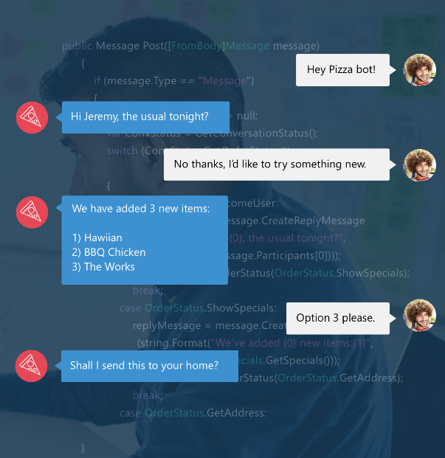
Bot Framework + Azure Bot Service
Accelerate development
Framework, tools and services to build great bots that converse naturally
Reach any user
Develop once and expose through any channel including Skype, Facebook, web
Notes:
The Microsoft Bot Framework allows you to build and connect intelligent bots to interact with your users.
Interact with users from your website or app to Skype, Teams, Office 365 mail, Slack, Facebook Messenger, and Cortana.
And the Azure Bot Service that’s in preview provides an intelligent bot service that scales on demand, and many out-of-the-box templates to get started.

Slide 37
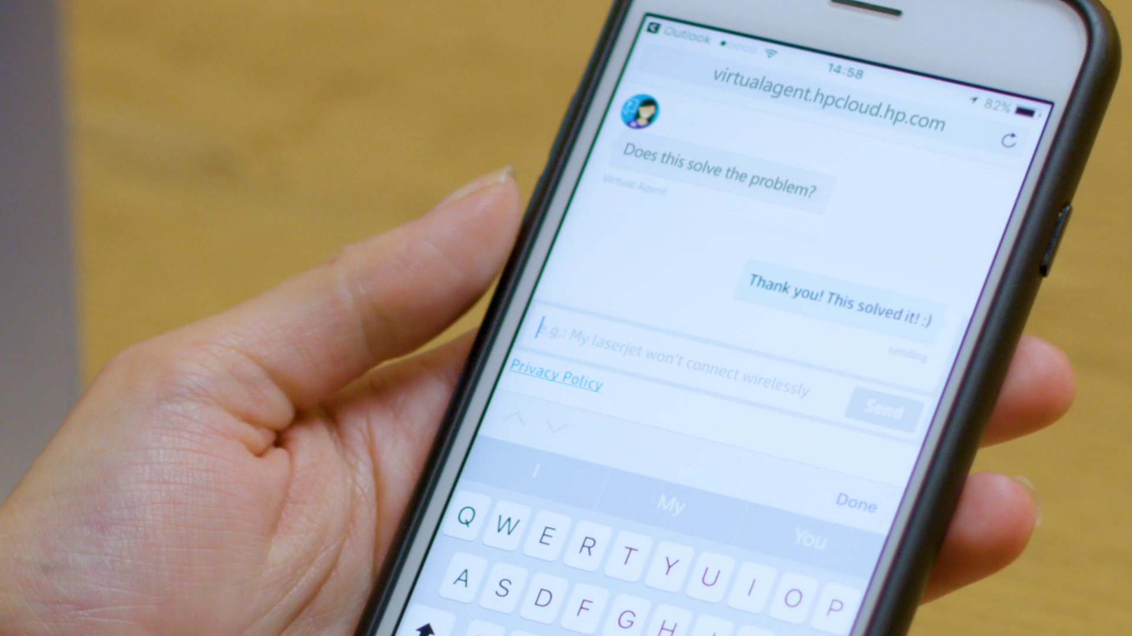
4. Intelligent Bots
Conversational AI
Conversational AI
Notes:
This brings me to my fourth scenario. Intelligent Chat Bots for the enterprise.
When computers can speak “human,” every human can speak with computers.
The best way to show what you can build today with Azure Bot Service and Cognitive Services is with a demo.

Slide 38
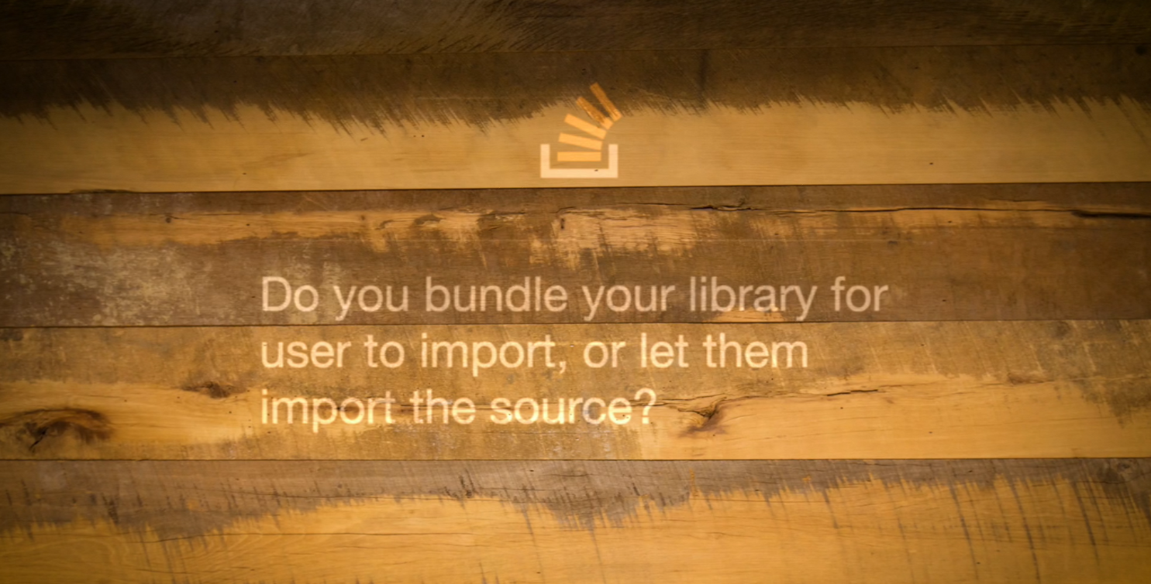

DEMO
Wee Hyong Tok
Principal Data Scientist
@weehyong
Notes:
Now, I’d like to invite on stage Wee Hyong, who is a Principal Data Scientist in my team, to show us the StackOverflow bot and the tooling that enables these types of solutions for every developer.

Slide 39
Stackoverflow
Notes:
StackOverflow provides the world’s largest developer community.
Each month, over 50 million developers come to Stack Overflow to learn, share their knowledge, and build their careers.
We are excited to partner with Stackoverflow, to apply AI at whole new level to empower developers to exponentially accelerating their productivity and success.

Slide 40

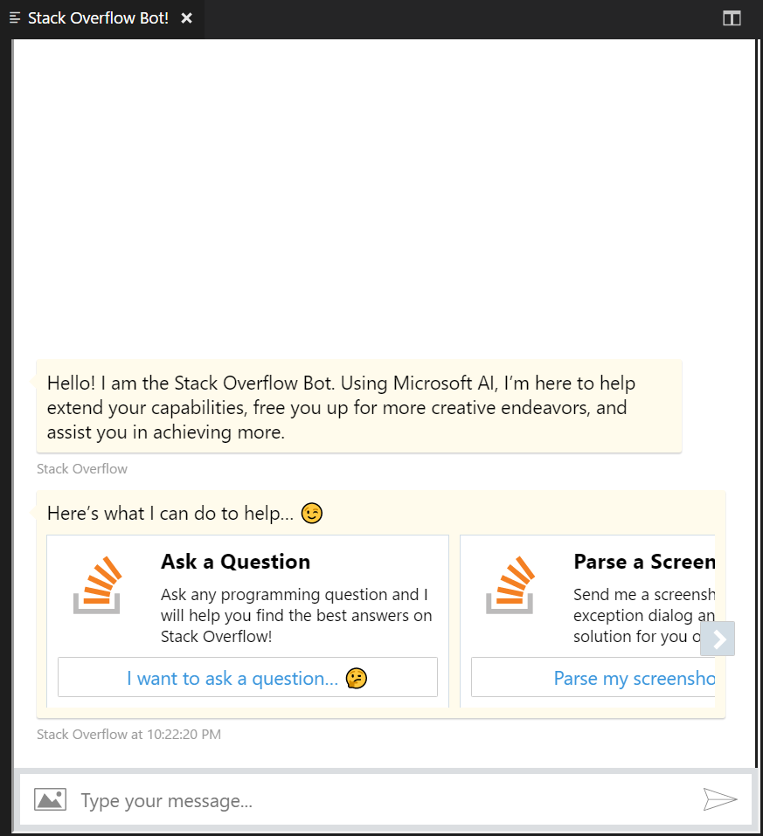
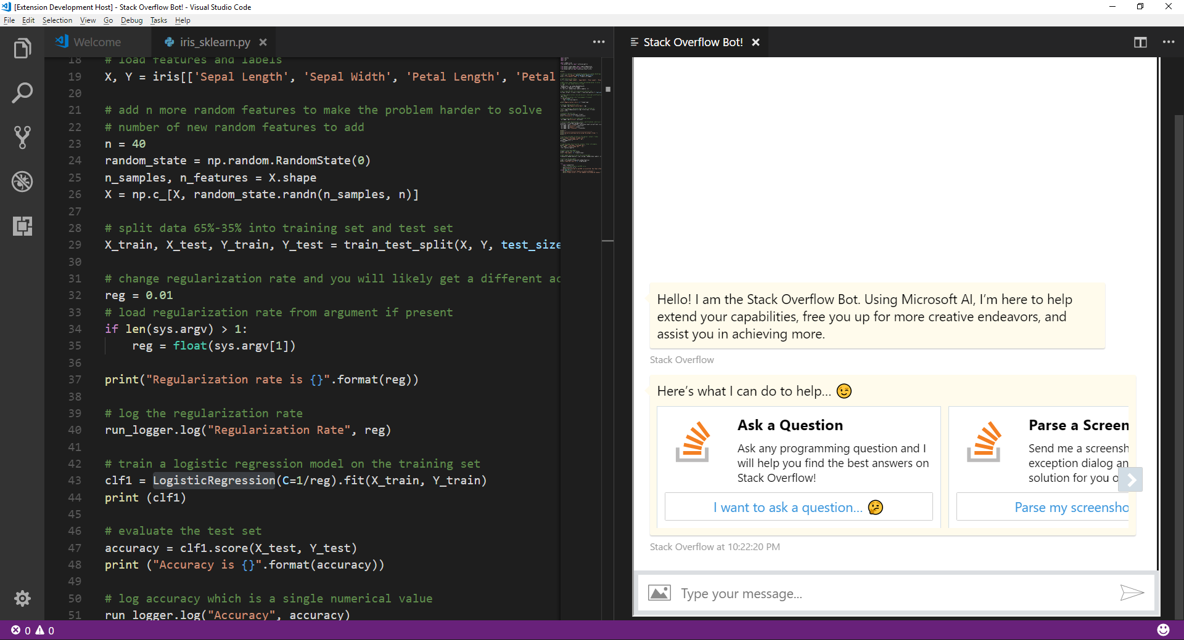
Stack Overflow Bot & AI Architecture
Cognitive Services + Azure Functions (Text Analytics, OCR, Computer Vision, Bing Custom Search)
Stack Overflow Bot + Visual Studio Code
Notes:
So to recap, here’s the AI architecture behind the Stack Overflow bot that you just saw.

Slide 41
Cognitive Understanding
“Understanding”
Microsoft
AI Platform
Capabilities
Building custom AI models from data
Real-time AI at the Edge
Cognitive applications
“Reasoning”
Conversational AI & Bots
“Natural UI”
Notes:
Let me step back and summarise the capabilities of the platform.
1. Cognitive Understanding of documents for Understanding <click>
2. Building custom AI models @ scale & 3. Real-time AI at the edge for Reasoning & Automating <click>
4. Conversational AI applications for Natural UI
The platform brings the best of the cloud to AI developers, and the best of AI to cloud developers. And it is the most disruptive platform for building systems of intelligence today.

Slide 42

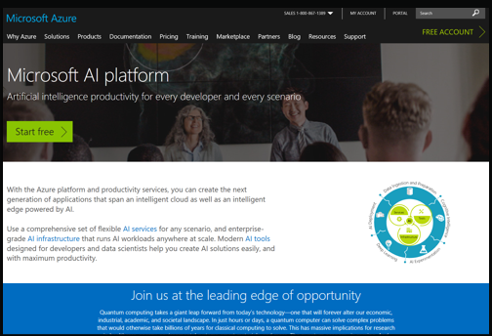
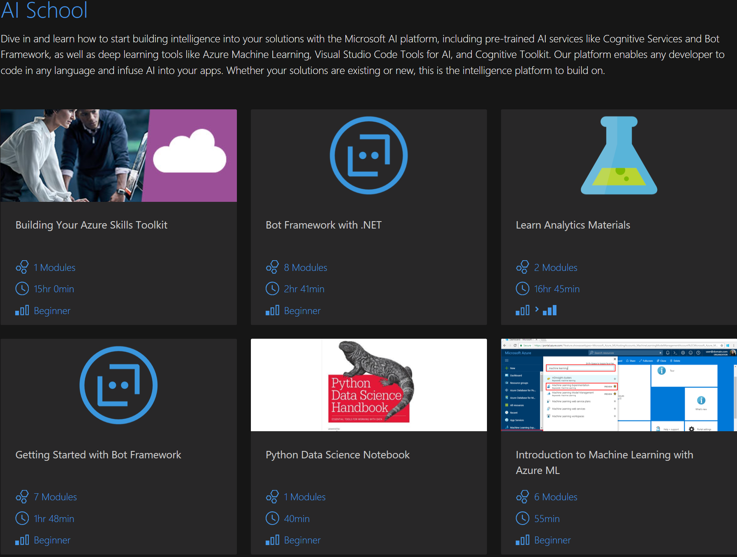
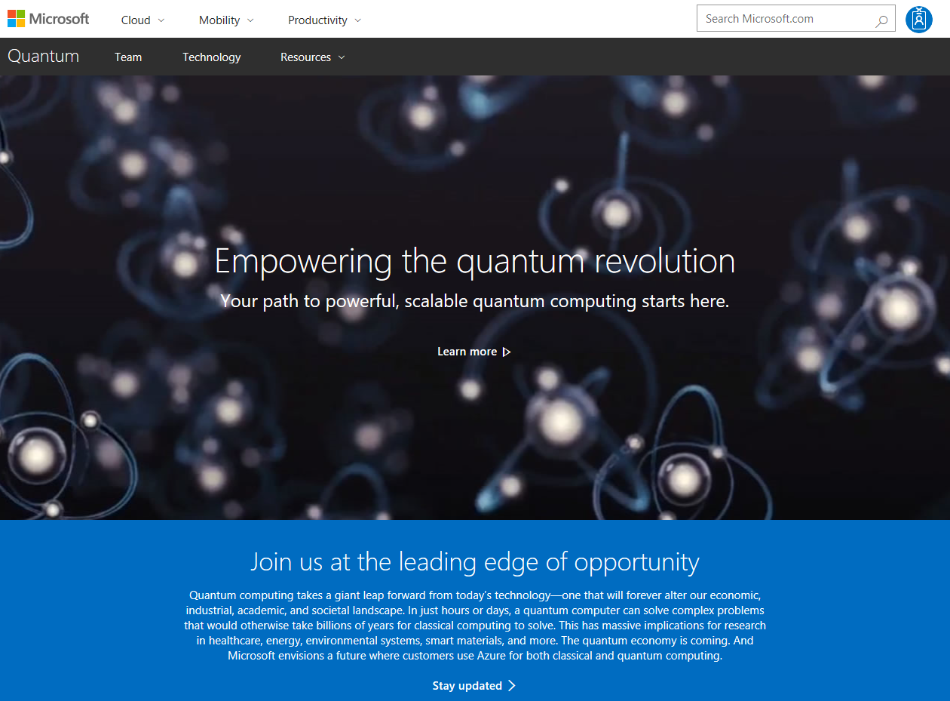
azure.com/ai
aischool.microsoft.com
Resources
Notes:
I invite all of you to dig in, with our new set of training resources, the AI School, which will guide you through getting up to speed and start to infuse AI into your applications today.

Slide 43

Thank you
Joseph Sirosh
CVP, Microsoft Corporation
@josephsirosh

